Slide 1


Artificial and Computational Intelligence
AIMLCLZG557
Contributors & Designers of document content : Cluster Course Faculty Team
M2 : : Problem Solving Agent using Search
BITS Pilani
Pilani Campus
Presented by
Dr. Srinivasa L.Chakravarthy
Chakri.ls@wilp.bits-Pilani.ac.in

Slide 2

Artificial and Computational Intelligence
Disclaimer and Acknowledgement
Few content for these slides may have been obtained from prescribed books and various other source on the Internet
I hereby acknowledge all the contributors for their material and inputs and gratefully acknowledge people others who made their course materials freely available online.
.I have provided source information wherever necessary
This is not a full fledged reading materials. Students are requested to refer to the textbook w.r.t detailed content of the presentation deck that is expected to be shared over e-learning portal - taxilla.
I have added and modified the content to suit the requirements of the class dynamics & live session’s lecture delivery flow for presentation
Slide Source / Preparation / Review:
From BITS Pilani WILP: Prof.Raja vadhana, Prof. Indumathi, Prof.Sangeetha
From BITS Oncampus & External : Mr.Santosh GSK

Slide 3
Course Plan
M1 | Introduction to AI
M2 | Problem Solving Agent using Search
M3 | Game Playing
M4 | Knowledge Representation using Logics
M5 | Probabilistic Representation and Reasoning
M6 | Reasoning over time, Reinforcement Learning
M7 | Ethics in AI

Slide 4
Learning Objective
At the end of this class , students Should be able to:
Compare given heuristics for a problem and analyze which is the best fit
Design relaxed problem with appropriate heuristic design
Prove the designed relaxed problem heuristic is admissible
Differentiate which local search is best suitable for given problem
Design fitness function for a problem
Construct a search tree
Apply appropriate local search and show the working of algorithm at least for first 2 iterations with atleast four next level successor generation(if search tree is large)
Design and show Genetic Algorithm steps for a given problem

Slide 5
Module 2 : Problem Solving Agent using Search
Uninformed Search
Informed Search
Heuristic Functions
D. Local Search Algorithms & Optimization Problems

Slide 6
Design of Heuristics

Slide 7
Heuristic Design
Effective Branching Factor
Good Heuristics
Notion of Relaxed Problems
Generating Admissible Heuristics
Effective branching factor (b∗):
If the algorithm generates N number of nodes and the solution is found at depth d, then
N + 1 = 1 + (b∗) + (b∗)² + (b∗)³ + ... + (b∗)^{d}

Slide 8
Heuristic Design
Effective Branching Factor
Good Heuristics
Notion of Relaxed Problems
Generating Admissible Heuristics
Simplify the problem
Assume no constraints
Cost of optimal solution to relaxed problem ≤ Cost of optimal solution for real problem

Slide 9
 | Q
 |  |  | Q
Q
 |  | Q
Q1
 | Q2
N-Queen
Initial State
Goal State
Construct the search tree by
considering one row of the board
at a time
State space graph of relaxed problem
is a super graph of original state space
because of removal of restrictions
Q3 | .. | .. | ..
Q1
 | Q2
 | .. | Q3 | ..
Q1
 | Q2
.. | .. | .. | Q3
Q1
 | Q2
Q1
.. | … | .. | Q3
 | Q2
Initial State | Possible Actions | Transition Model | Goal Test | Path Cost | No.Of.States
< Xi , Yi > | Place in any non-occupied row in board |  | isValid Non-Attacking | Transition + Valid Queens | n!

Slide 10
 | Q
 |  |  | Q
Q
 |  | Q
Q1
 | Q2
N-Queen
Initial State
Goal State
Q3 | .. | .. | ..
Q1
 | Q2
 | .. | Q3 | ..
Q1
 | Q2
.. | .. | .. | Q3
Q1
 | Q2
Q1
.. | … | .. | Q3
 | Q2
Possible Heuristic Design:
H1(n) : Number of Non conflicting Pairs of Queen (MAX)
H2(n) : Number of Conflicting Pairs of Queen (MIN)
H1(n) : Number of safest Queen (MAX)

Slide 11
 | Q
 |  |  | Q
Q
 |  | Q
Q1
 | Q2
N-Queen
Initial State
Goal State
Q3 | .. | .. | ..
Q1
 | Q2
 | .. | Q3 | ..
Q1
 | Q2
.. | .. | .. | Q3
Q1
 | Q2
Q1
.. | … | .. | Q3
 | Q2
 |  | Q3
Q1
Q4 | .. | .. | ..
 | Q2
 |  | Q3
Q1
.. | .. | .. | Q4
 | Q2
.. | Q4 | .. | ..
Q1
 |  |  | Q3
 | Q2
.. | .. | Q4 | ..
Q1
 |  |  | Q3
 | Q2

Slide 12
- | 1 | 2
3 | 4 | 5
6 | 7 | 8
1 | 7 | 6
4 | 8 | 5
- | 2 | 3
N-Tile
Initial State
Goal State
Effective Branching Factor
: ~3
: Avg.cost = 18
: No.of.States = ~ 3 ¹⁸
: Graph states : 9!/2 = 181, 440 states
1 | 7 | 6
4 | 8 | 5
2 | - | 3
1 | 7 | 6
- | 8 | 5
4 | 2 | 3
1 | 7 | 6
4 | - | 5
2 | 8 | 3
1 | 7 | 6
4 | 8 | 5
2 | 3 | -
1 | 7 | 6
8 | - | 5
4 | 2 | 3
- | 7 | 6
1 | 8 | 5
4 | 2 | 3
Initial State | Possible Actions | Transition Model | Goal Test | Path Cost | No.Of.States
<LOC, ID> | Move Empty to near by Tile |  | ID=LOC+1 | Transition + Positional + Distance+ Other approaches | 9!

Slide 13
N-Tile
- | 1 | 2
3 | 4 | 5
6 | 7 | 8
1 | 7 | 6
4 | 8 | 5
- | 2 | 3
Initial State
Goal State
1 | 7 | 6
4 | 8 | 5
2 | - | 3
1 | 7 | 6
- | 8 | 5
4 | 2 | 3
1 | 7 | 6
4 | - | 5
2 | 8 | 3
1 | 7 | 6
4 | 8 | 5
2 | 3 | -
1 | 7 | 6
8 | - | 5
4 | 2 | 3
- | 7 | 6
1 | 8 | 5
4 | 2 | 3
Possible Heuristic Design:
H1(n) : Manhattan distance of Empty tile
H1(n) : Manhattan distance of all labelled tile
H1(n) : Number of Misplaced tile (MAX)

Slide 14
Learn from experience
- | 1 | 2
3 | 4 | 5
6 | 7 | 8
Trail / Puzzle | X1(n) : No.of.Misplaced Tiles | X2(n): Pair of adjacent tiles that are not in goal | X3(n): Position of the empty tile | …………h`(n)
Example 1 | 7 | 10 | 7 | ………….
Example 2 | 5 | 6 | 6 | ………….
……… | .. | .. | .. | ………….
1 | 7 | 6
4 | 8 | 5
- | 2 | 3
Create a suitable model:
h(n) = c1*X1(n) + c2*X2(n) + ………..

Slide 15
Local Search & Optimization

Slide 16
Local Search
Optimization Problem
Goal : Navigate through a state space for a given problem such that an optimal solution can be found
Objective : Minimize or Maximize the objective evaluation function value
Scope : Local
Objective Function : Fitness Value evaluates the goodness of current solution
Local Search : Search in the state-space in the neighbourhood of current position until an optimal solution is found
Single Instance Based Multiple Instance Based
Hill Climbing Genetic Algorithm
Simulated Annealing Particle Swarm Optimization
Local Beam Search Ant Colony Optimization
Tabu Search

Slide 17

Local Search
Terminology
Local Search : Search in the state-space in the neighbourhood of current position until an optimal solution is found
Algorithms:
Choice of Neighbor
Looping Condition
Termination Condition
Global maximum
Local maximum
YOU ARE HERE
2 | 5 | 3 | 2
 | 6
3 | 5 | 4 | 2
4 |  | 4 | 2
Fitness
value
Local minimum
Global minimum
Feasible State Space

Slide 18
Hill Climbing

Slide 19
Hill Climbing
Global maximum
Local maximum
YOU ARE HERE
Fitness
value
Local minimum
Global minimum
Feasible State Space

Slide 20

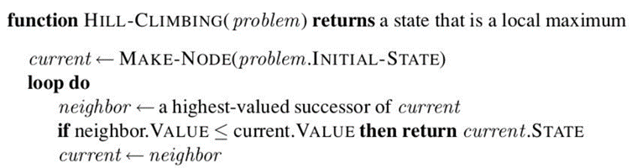
Hill Climbing
Random Restart
Select a random state
Evaluate the fitness scores for all the successors of the state
Select the next state based on the highest fitness
Repeat from Step 2
3 | 4 | 4 | 2 | 3

Slide 21
Hill Climbing
Select a random state
Evaluate the fitness scores for all the successors of the state
h(n) = No.of non-conflicting pairs of queens in the board.
Q1-Q2
Q1-Q3
Q1-Q4
Q2-Q3
Q2-Q4
Q3-Q4
Note : Steps 3 & 4 in the above algorithm will be a part of variation of Hill climbing
1 | 4 | 2 | 2 | 4

Slide 22
Hill Climbing
Select a random state
Evaluate the fitness scores for all the successors of the state
1 | 4 | 2 | 2 |  |  | 2 | 4 | 2 | 2 |  |  | 4 | 4 | 2 | 2 |  |  | 1 | 4 | 1 | 2

Slide 23
Hill Climbing
Local Maxima → Random Restart
1 | 4 | 2 | 2 | 4 |  | 2 | 4 | 2 | 2 | 2 |  | 4 | 4 | 2 | 2 | 2 |  | 1 | 4 | 1 | 2 | 3

Slide 24
Hill Climbing
Random Restart
Select a random state
Evaluate the fitness scores for all the successors of the state
Calculate the probability of selecting a successor based on fitness score
Select the next state based on the highest probability
Repeat from Step 2
3 | 4 | 4 | 2 | 3

Slide 25
Hill Climbing
Select a random state
Evaluate the fitness scores for all the successors of the state
Calculate the probability of selecting a successor based on fitness score
Select the next state based on the highest probability
Repeat from Step 2
3 | 4 | 4 | 2 | 3 |  | 3 | 3 | 4 | 2 | 4 |  | 3 | 1 | 4 | 2 | 6 |  | 3 | 2 | 4 | 2 | 4

Slide 26
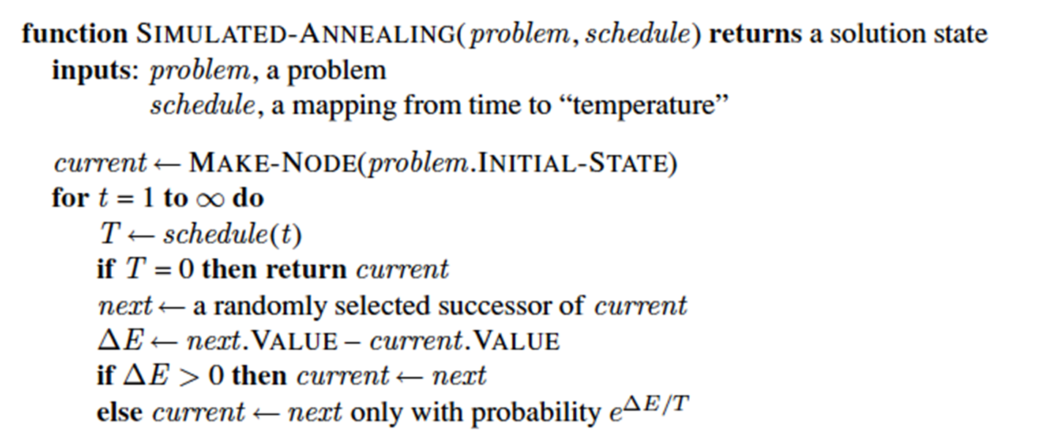
Stochastic Hill Climbing

Slide 27
Stochastic Hill Climbing
Select a random state
Evaluate the fitness scores for all the successors of the state
Calculate the probability of selecting a successor based on fitness score
Select the next state based on the highest probability
Repeat from Step 2
Local Maxima → Random Restart
1 | 4 | 2 | 2 | 4 |  | 2 | 4 | 2 | 2 | 2 |  | 4 | 4 | 3 | 3 | 2 |  | 1 | 4 | 1 | 2 | 3
 |  |  |  | 0.16 |  |  |  |  |  | 0.08 |  |  |  |  |  | 0.08 |  |  |  |  | 0.13
 |  |  |  | 0.08 |  |  |  |  |  | 0.42 |  |  |  |  |  | 0.42 |  |  |  |  | 0.25
12 N = {4,2,2,3,3,2,1,3,2,1,3,2}

Slide 28
Simulated Annealing

Slide 30
Simulated Annealing
Select a random state
Evaluate the fitness scores for all the successors of the state
Calculate the probability of selecting a successor based on fitness score
Select the next state based on the highest probability
Repeat from Step 2
12 N = {4,2,2,3,3,2,1,3,2,1,3,2}
Init = 2
1 | 4 | 2 | 2 | 4 |  | 2 | 4 | 2 | 2 | 2 |  | 4 | 4 | 3 | 3 | 2 |  | 1 | 4 | 1 | 2 | 3
 |  |  |  | 0.55 |  |  |  |  |  | 0.5 |  |  |  |  |  | 0.5 |  |  |  |  | 0.525

Slide 31
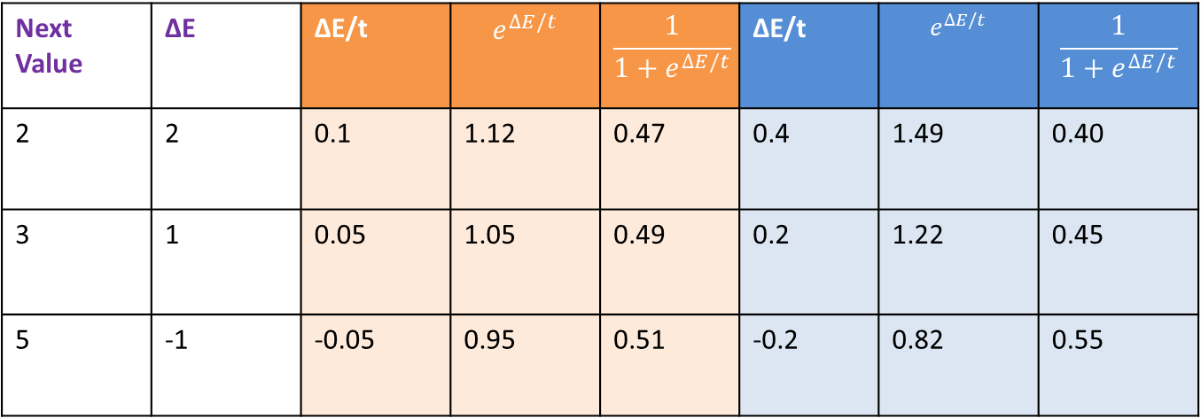
Simulated Annealing
Current Value = 4 (Local Maxima)
Global Maxima = 6
Next Value | ∆E | ∆E/t | $$e^{∆E/t}$$ | $$\frac{1}{1+e^{∆E/t}}$$ | ∆E/t | $$e^{∆E/t}$$ | $$\frac{1}{1+e^{∆E/t}}$$
2 | 2 | 0.1 | 1.12 | 0.47 | 0.4 | 1.49 | 0.40
3 | 1 | 0.05 | 1.05 | 0.49 | 0.2 | 1.22 | 0.45
5 | -1 | -0.05 | 0.95 | 0.51 | -0.2 | 0.82 | 0.55

Slide 32
Simulated Annealing
Maximization problem design to achieve global minima
Set Temp to very high temp t
Set n as number of iteration to be performed at a particular t
L1: Randomly select a random neighbour
Calculate Energy barrier E = f(N)-f(C)
If E > 0 then its a good move
Move ahead for next tree search level
Else
Create a random number r:[0-1]
If r< e^{-E/t}
Choose this bad state & move downhill
Else
Go to L1.
If Goal is reached or {acceptable goal(set criteria to check )node is reached & t is small END}
Else
If no.of.neighbors explored has reached a threshold >=n
then Lower t and go to L1.

Slide 33
Local Beam Search

Slide 34
Beam Search
Initialize k random state
Evaluate the fitness scores for all the successors of the k states
Calculate the probability of selecting a successor based on fitness score
Select the next state based on the highest probability
If the goal is not found, Select the next ‘k’ states randomly based on the probability
Repeat from Step 2
3 | 4 | 4 | 2 | 3 |  | 3 | 3 | 4 | 2 | 4 |  | 3 | 1 | 4 | 2 | 6 |  | 3 | 2 | 4 | 2 | 4

Slide 35
Stochastic Beam Search
Sample from 1st State
Initialize k random state
Evaluate the fitness scores for all the successors of the k states
Calculate the probability of selecting a successor based on fitness score
Select the next state based on the highest probability
If the goal is not found, Select the next ‘k’ states randomly based on the probability
Repeat from Step 2
1 | 4 | 2 | 2 | 4 |  | 2 | 4 | 2 | 2 | 2 |  | 4 | 4 | 3 | 3 | 2 |  | 1 | 4 | 1 | 2 | 3

Slide 36
Genetic Algorithm

Slide 37
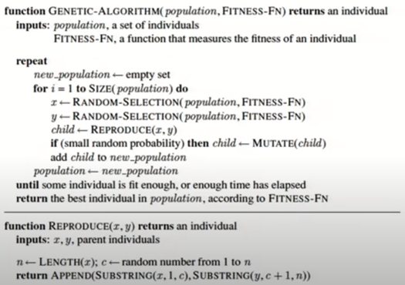
Genetic Algorithm

Slide 38
Genetic Algorithm
Select ‘k’ random states – Initialization : k=4
Evaluate the fitness value all states
If anyone of the state’s has achieved the threshold fitness value or threshold new states or no change is seen than previous iteration then the algorithm stops
Else, use roulette wheel mechanism to select pair/s
Pairs selected produces new state (successor) by crossover
Successor is allowed to mutate
Repeat from Step 2
1 | 4 | 2 | 2 |  |  | 2 | 1 | 3 | 4 |  |  | 1 | 4 | 3 | 2 |  |  | 2 | 1 | 4 | 1

Slide 39
Genetic Algorithm
Select ‘k’ random states – Initialization : k=4
Evaluate the fitness value all states : Maximizing function : No.of.Non-attacking pairs Queens → Threshold = 6
If anyone of the state’s has achieved the threshold fitness value or threshold new states or no change is seen than previous iteration then the algorithm stops
Else, use roulette wheel mechanism to select pair/s
Pairs selected produces new state (successor) by crossover
Successor is allowed to mutate
Repeat from Step 2
1 | 4 | 2 | 2 | 4 |  | 2 | 1 | 3 | 4 | 4 |  | 1 | 4 | 3 | 2 | 2 |  | 2 | 1 | 4 | 1 | 3

Slide 40
Genetic Algorithm – Example 1
Eg., use roulette wheel mechanism to select pair/s
Sample winners of game -1 ,2,3,4 : B4, B1, B1, B3
1 | 4 | 2 | 3 | 5 |  | 2 | 1 | 3 | 4 | 4 |  | 1 | 4 | 3 | 2 | 2 |  | 2 | 1 | 3 | 4 | 4
 |  |  |  | 0.33 |  |  |  |  |  | 0.27 |  |  |  |  |  | 0.13 |  |  |  |  | 0.27
2 | 1 | 3 | 4 |  |  | 1 | 4 | 2 | 3 |  |  | 1 | 4 | 2 | 3 |  |  | 1 | 4 | 3 | 2

Slide 41
Genetic Algorithm –Example 2
Selection
Select ‘k’ random states – Initialization : k=4
Evaluate the fitness value all states : Maximizing function : No.of.Non-attacking pairs Queens → Threshold = 6
If anyone of the state’s has achieved the threshold fitness value or threshold new states or no change is seen than previous iteration then the algorithm stops
Else, use roulette wheel mechanism to select pair/s
Pairs selected produces new state (successor) by crossover
Successor is allowed to mutate
Repeat from Step 2
Sample winners of game -1 ,2,3,4 : B4, B1, B1, B3
1 | 4 | 2 | 2 | 4 |  | 2 | 1 | 3 | 4 | 4 |  | 1 | 4 | 3 | 2 | 2 |  | 2 | 1 | 4 | 1 | 3
 |  |  |  | 0.31 |  |  |  |  |  | 0.31 |  |  |  |  |  | 0.15 |  |  |  |  | 0.23
2 | 1 | 4 | 1 |  |  | 1 | 4 | 2 | 2 |  |  | 1 | 4 | 2 | 2 |  |  | 1 | 4 | 3 | 2

Slide 42
Genetic Algorithm - Example 2
Crossover
Select ‘k’ random states – Initialization : k=4
Evaluate the fitness value all states : Maximizing function : No.of.Non-attacking pairs Queens → Threshold = 6
If anyone of the state’s has achieved the threshold fitness value or threshold new states or no change is seen than previous iteration then the algorithm stops
Else, use roulette wheel mechanism to select pair/s
Pairs selected produces new state (successor) by crossover
Successor is allowed to mutate
Repeat from Step 2
1 | 4 | 2 | 2 | 4 |  | 2 | 1 | 3 | 4 | 4 |  | 1 | 4 | 3 | 2 | 2 |  | 2 | 1 | 4 | 1 | 3
 |  |  |  | 0.31 |  |  |  |  |  | 0.31 |  |  |  |  |  | 0.15 |  |  |  |  | 0.23
2 | 1 | 4 | 1 |  |  | 1 | 4 | 2 | 2 |  |  | 1 | 4 | 2 | 2 |  |  | 1 | 4 | 3 | 2
2 | 4 | 2 | 2 |  |  | 1 | 1 | 4 | 1 |  |  | 1 | 4 | 3 | 2 |  |  | 1 | 4 | 2 | 2

Slide 43
Genetic Algorithm - Example 2
Mutation
Select ‘k’ random states – Initialization : k=4
Evaluate the fitness value all states : Maximizing function : No.of.Non-attacking pairs Queens → Threshold = 6
If anyone of the state’s has achieved the threshold fitness value or threshold new states or no change is seen than previous iteration then the algorithm stops
Else, use roulette wheel mechanism to select pair/s
Pairs selected produces new state (successor) by crossover
Successor is allowed to mutate
Repeat from Step 2
2 | 4 | 2 | 2 |  |  | 1 | 1 | 4 | 1 |  |  | 1 | 4 | 3 | 2 |  |  | 1 | 4 | 2 | 2
2 | 4 | 1 | 2 |  |  | 1 | 3 | 4 | 1 |  |  | 1 | 4 | 3 | 2 |  |  | 1 | 4 | 2 | 3

Slide 44
Genetic Algorithm
Select ‘k’ random states – Initialization : k=4
Evaluate the fitness value all states : Maximizing function : No.of.Non-attacking pairs Queens → Threshold = 6
If anyone of the state’s has achieved the threshold fitness value or threshold new states or no change is seen than previous iteration then the algorithm stops
Else, use roulette wheel mechanism to select pair/s
Pairs selected produces new state (successor) by crossover
Successor is allowed to mutate
Repeat from Step 2
2 | 4 | 2 | 2 |  |  | 1 | 1 | 4 | 1 |  |  | 1 | 4 | 3 | 2 |  |  | 1 | 4 | 2 | 2
2 | 4 | 1 | 2 | 3 |  | 1 | 3 | 4 | 1 | 3 |  | 1 | 4 | 3 | 2 | 2 |  | 1 | 4 | 2 | 3 | 5
 |  |  |  | 0.23 |  |  |  |  |  | 0.23 |  |  |  |  |  | 0.15 |  |  |  |  | 0.39

Slide 45
Genetic Algorithm
Select ‘k’ random states – Initialization : k=4
Evaluate the fitness value all states : Maximizing function : No.of.Non-attacking pairs Queens → Threshold = 6
If anyone of the state’s has achieved the threshold fitness value or threshold new states or no change is seen than previous iteration then the algorithm stops
Else, use roulette wheel mechanism to select pair/s
Pairs selected produces new state (successor) by crossover
Successor is allowed to mutate
Repeat from Step 2
1st Parent 2nd Parent 3rd Parent 4th Parent
Other crossover and mutation operators are shared in separate document & uploaded in the elearn portal
*
2 | 4 | 1 | 2 | 3 |  | 1 | 3 | 4 | 1 | 3 |  | 1 | 4 | 3 | 2 | 2 |  | 1 | 4 | 2 | 3 | 5
 |  |  |  | 0.23 |  |  |  |  |  | 0.23 |  |  |  |  |  | 0.15 |  |  |  |  | 0.39
1 | 4 | 2 | 3 |  |  | 2 | 4 | 1 | 2 |  |  | 1 | 3 | 4 | 1 |  |  | 1 | 4 | 2 | 3

Slide 46
Genetic Algorithm
Select ‘k’ random states – Initialization : k=4
Evaluate the fitness value all states : Maximizing function : No.of.Non-attacking pairs Queens → Threshold = 6
If anyone of the state’s has achieved the threshold fitness value or threshold new states or no change is seen than previous iteration then the algorithm stops
Else, use roulette wheel mechanism to select pair/s
Pairs selected produces new state (successor) by crossover
Successor is allowed to mutate
Repeat from Step 2
1 | 4 | 2 | 3 |  |  | 2 | 4 | 1 | 2 |  |  | 1 | 3 | 4 | 1 |  |  | 1 | 4 | 2 | 3
1 | 4 | 2 | 2 |  |  | 2 | 4 | 1 | 3 |  |  | 1 | 3 | 4 | 3 |  |  | 1 | 4 | 2 | 1
1 | 4 | 3 | 2 | 2 |  | 2 | 4 | 1 | 3 | 6 |  | 1 | 1 | 4 | 3 | 3 |  | 1 | 4 | 2 | 1 | 4

Slide 47
Genetic Algorithm
Techniques:
Design of the fitness function
Diversity in the population to be accounted
Randomization
Application:
Creative tasks
Exploratory in nature
Planning problem
Static Applications

Slide 48
Required Reading: AIMA - Chapter # 4.1, #4.2
Note : Some of the slides are adopted from AIMA TB materials
Thank You for all your Attention
48
Notes:
48

